Slide 2
Read for mood
Why does Paul feel the way he does?

Slide 3
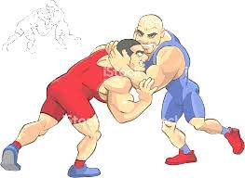
Wrestling with Romans 9-10
God let people be born for condemnation?
How can He be loving?

Slide 4
Anguish over the Lost
Romans 9:1-24
with 9:30-32a, 10:1-4, 8-18a

Slide 5
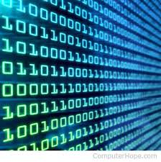
Salvation or judgment
There will be judgment.
Jesus is the only salvation.
Apart from Jesus, people will face judgment on their own merit.
God is Judge
We are not

Slide 6
Romans 9:1-5
I am speaking the truth in Christ—I am not lying; my conscience bears me witness in the Holy Spirit— that I have great sorrow and unceasing anguish in my heart. For I could wish that I myself were accursed and cut off from Christ for the sake of my brothers, my kinsmen according to the flesh. They are Israelites, and to them belong the adoption, the glory, the covenants, the giving of the law, the worship, and the promises. To them belong the patriarchs, and from their race, according to the flesh, is the Christ, who is God over all, blessed forever. Amen.

Slide 7
Romans 9:6-13
But it is not as though the word of God has failed. For not all who are descended from Israel belong to Israel, and not all are children of Abraham because they are his offspring, but “Through Isaac shall your offspring be named.” This means that it is not the children of the flesh who are the children of God, but the children of the promise are counted as offspring. For this is what the promise said: “About this time next year I will return, and Sarah shall have a son.” And not only so, but also when Rebekah had conceived children by one man, our forefather Isaac, though they were not yet born and had done nothing either good or bad—in order that God's purpose of election might continue, not because of works but because of him who calls— she was told, “The older will serve the younger.” As it is written, “Jacob I loved, but Esau I hated.”

Slide 8
Romans 9:14-19
What shall we say then? Is there injustice on God's part? By no means! For he says to Moses, “I will have mercy on whom I have mercy, and I will have compassion on whom I have compassion.” So then it depends not on human will or exertion, but on God, who has mercy. For the Scripture says to Pharaoh, “For this very purpose I have raised you up, that I might show my power in you, and that my name might be proclaimed in all the earth.” So then he has mercy on whomever he wills, and he hardens whomever he wills.

Slide 9
Romans 9:20-24
You will say to me then, “Why does he still find fault? For who can resist his will?” But who are you, O man, to answer back to God? Will what is molded say to its molder, “Why have you made me like this?” Has the potter no right over the clay, to make out of the same lump one vessel for honorable use and another for dishonorable use? What if God, desiring to show his wrath and to make known his power, has endured with much patience vessels of wrath prepared for destruction, in order to make known the riches of his glory for vessels of mercy, which he has prepared beforehand for glory— even us whom he has called, not [only] from the Jews only but also from the Gentiles?

Slide 10
Romans 9:30-32a
What shall we say, then? That Gentiles who did not pursue righteousness have attained it, that is, a righteousness that is by faith; but that Israel who pursued a law that would lead to righteousness did not succeed in reaching that law. Why? Because they did not pursue it by faith, but as if it were based on works.

Slide 11
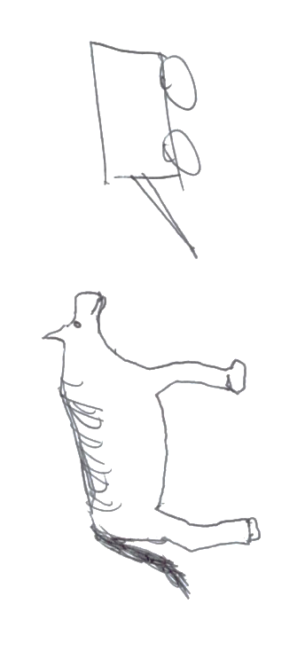
Message of Romans 9
Salvation is a gift
If you pay, it’s not a gift.
Paul’s fellow Jewish people
Rejected the Cross and relied on themselves
God chose some but not others.
Paul’s wishful thinking could not save them.
faith
works

Slide 12
Salvation or judgment
There will be judgment.
Jesus is the only salvation.
Apart from Jesus, people will face judgment on their own merit.
God does according to Who He is.

Slide 13
Romans 10:1-4
Brothers, my heart's desire and prayer to God for them is that they may be saved. For I bear them witness that they have a zeal for God, but not according to knowledge. For, being ignorant of the righteousness of God, and seeking to establish their own, they did not submit to God's righteousness. For Christ is the end of the law for righteousness to everyone who believes.

Slide 14
Romans 10:9-18a
…if you confess with your mouth that Jesus is Lord and believe in your heart that God raised him from the dead, you will be saved. For with the heart one believes and is justified, and with the mouth one confesses and is saved. For the Scripture says, “Everyone who believes in him will not be put to shame.” For there is no distinction between Jew and Greek; for the same Lord is Lord of all, bestowing his riches on all who call on him. For “everyone who calls on the name of the Lord will be saved.”
How then will they call on him in whom they have not believed? And how are they to believe in him of whom they have never heard? And how are they to hear without someone preaching? And how are they to preach unless they are sent? As it is written, “How beautiful are the feet of those who preach the good news!” But they have not all obeyed the gospel. For Isaiah says, “Lord, who has believed what he has heard from us?” So faith comes from hearing, and hearing through the word of Christ.
But I ask, have they not heard? Indeed they have…

Slide 15
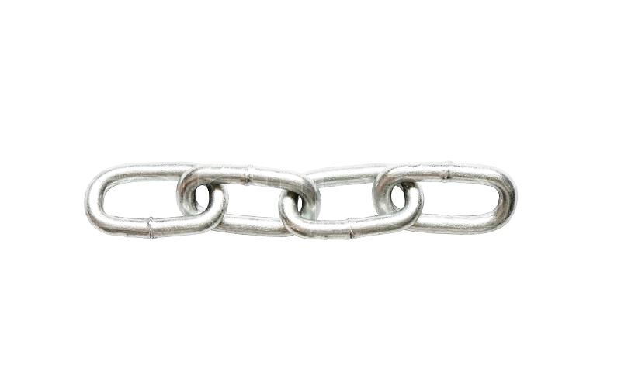
Chain of salvation
Believers sent
Believers preach
People hear
People believe and are saved
Without Jesus, people perish.
Fellow Jewish people heard but did not believe.

Slide 16
How the pros address exclusivity of the gospel
All religions have points of exclusivity.
What would happen if we accepted all truth claims in engineering?
Me or the car
Christ ian

Slide 17
How the Bible speaks of exclusivity
Necessity of Jesus is part of the Gospel itself.
John 3:16-18
John 6:53
Acts 4:12
Ephesians 2:4

Slide 18
John 3:16-18
For God so loved the world, that he gave his only Son, that whoever believes in him should not perish but have eternal life. For God did not send his Son into the world to condemn the world, but in order that the world might be saved through him. Whoever believes in him is not condemned, but whoever does not believe is condemned already, because he has not believed in the name of the only Son of God.

Slide 19
Gospel includes exclusivity
John 6:53. So Jesus said to them, “Truly, truly, I say to you, unless you eat the flesh of the Son of Man and drink his blood, you have no life in you.”
Acts 4:12. And there is salvation in no one else, for there is no other name under heaven given among men by which we must be saved.
Ephesians 2:4-5. But God, being rich in mercy, because of the great love with which he loved us, even when we were dead in our trespasses, made us alive together with Christ—by grace you have been saved.

Slide 20
How to respond?
Grieve like Paul!
God grieves, too. He desires all to be saved (Ezek 18:23,32; I Tim 2:3-4).
Pray like Paul
Preach like Paul
Do every right thing to get the Word out.
Pray desperately
Study diligently (both the Bible and what works)
Adapt without compromising truth
Love and serve both the body and the soul.

Slide 21
Why does it matter?
Motivation
Love of people
Glorify God
Heart
Soft hearts are motivated
Fruit
God desires fruit from all believers.

Slide 22
Do we really believe?
There will be judgment.
Jesus is the only salvation.
Apart from Jesus, people will face judgment on their own merit.
Impossible to ignore it!

Slide 23
Appendix: Jesus is the only way
John 3:3,5,13,18, 36; 6:44,53; 8:19,24,42; 14:6-7; 15:4-6
Acts 4:12
Acts 20:24-27 with Ezek. 33:1-9,12-20, 3:17-21
Galatians 1:6-10
Ephesians 2:1-3; we were dead before we believed. Before we heard the Gospel, we were dead. So must all unbelievers be dead until they hear and believe. (See also Col. 1:21-22).
I John 3:22-23, 5:5,10-12,21

Slide 24
Appendix: Hearing before believing
Hearing the Gospel always precedes believing it.
John 11:41-42, 17:20, 19:35, 20:30-31, 15:26-27
Acts 11:14, 13:38-49, 15:7,11, 10:42-43
Romans 1:20-21, 10:9-15,17
I Cor. 1:21
I Pet. 1:23

Slide 25
Appendix: Creation to Christ bible study
Genesis 2:4-25 God Creates People
Genesis 3:1-24 God holds people responsible for disobedience
Genesis 12:1-8, 15:1-6, 17:1-7 God’s Covenant with Abraham
Exodus 1:1-14, 2:11-25 God hears the cry of the defenseless
Exodus 3:1-22 God responds to the cry of the defenseless
Exodus 14:5-31 God defends his people from the oppressor
Leviticus 19:1-18 The Commands of God
Nehemiah 9:5-31 The people take responsibility for disobedience
Isaiah 61:1-9 The promise of a New Day
Jeremiah 31:31-34 God’s Covenant with the People
Matthew 3:13-17, 4:1-11 Jesus Is Baptized and Tested
Luke 4:14-21 Jesus Announces His Purpose
John 3:1-21 Jesus Teaches the Religious Teacher
John 4:1-26,39-42 Jesus Reveals Truth to the Samaritan Woman
Mark 6:30-44 Jesus Feeds the Five Thousand
Luke 5:17-26 Jesus Heals the Paralyzed Man
Matthew 22:34-40 Jesus Gives the Great Commandment
Mark 10:17-27 Jesus Challenges the Rich Young Ruler
Matthew 26:17-30 Jesus Talks about His Betrayal and Covenant
Matthew 26:47-57 Jesus is Arrested
Luke 23:32-56 Jesus is Crucified
Luke 24:1-35 Jesus is Resurrected
Acts 1:3-11 Jesus Ascends to Heaven
Acts 2:22-41 People respond to the message about Jesus
Acts 2:42-47 People create new community as Jesus-followers
Colossians 1:24-29 Jesus in His followers

